Slide 1

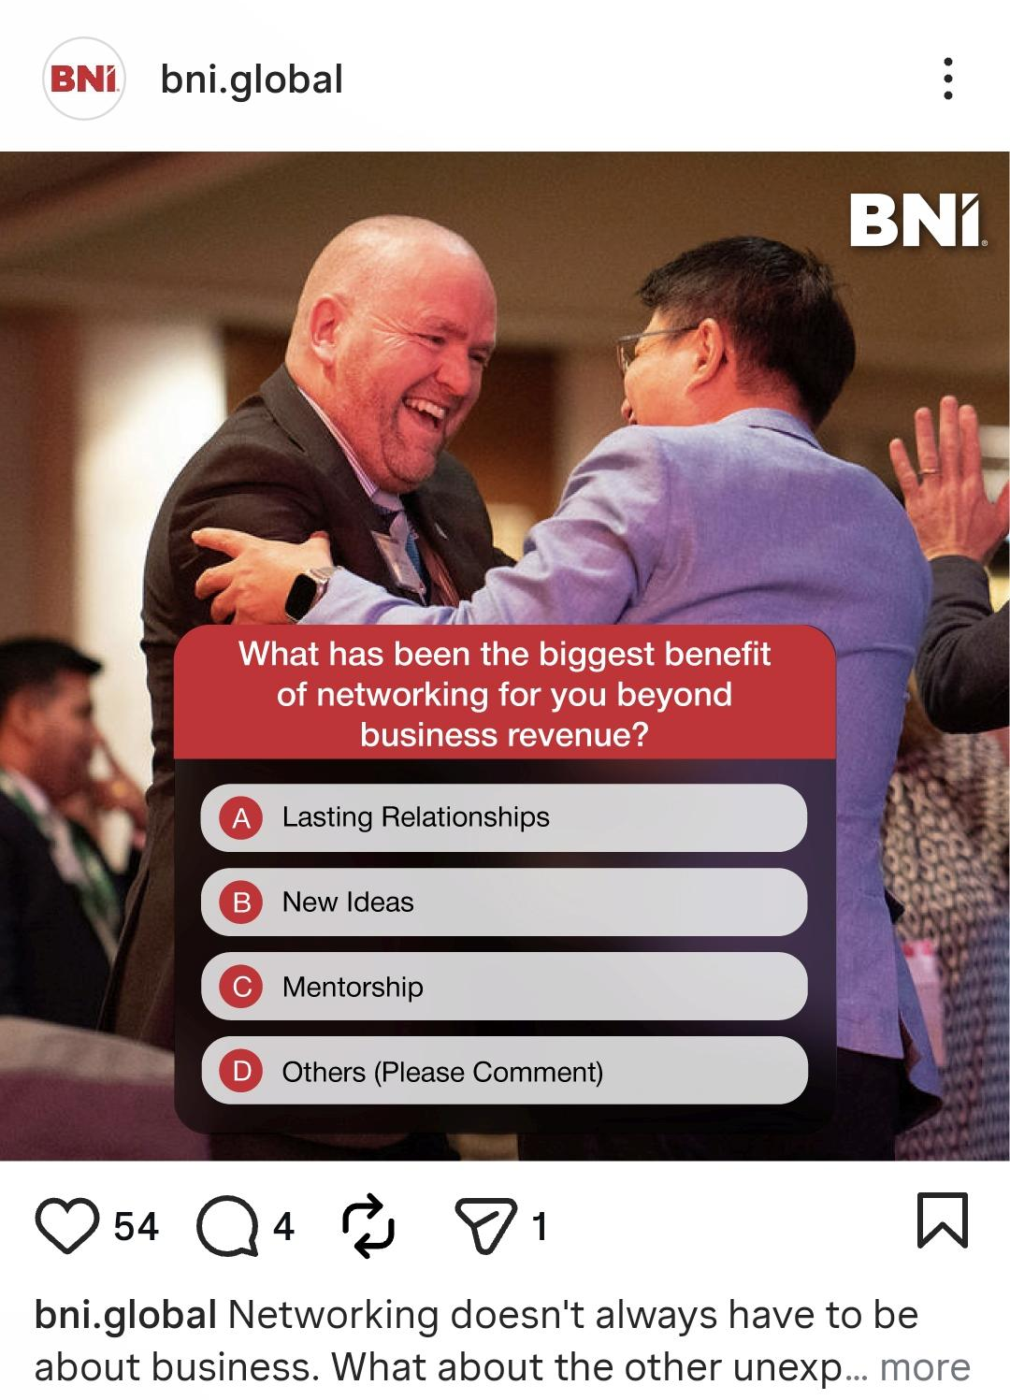
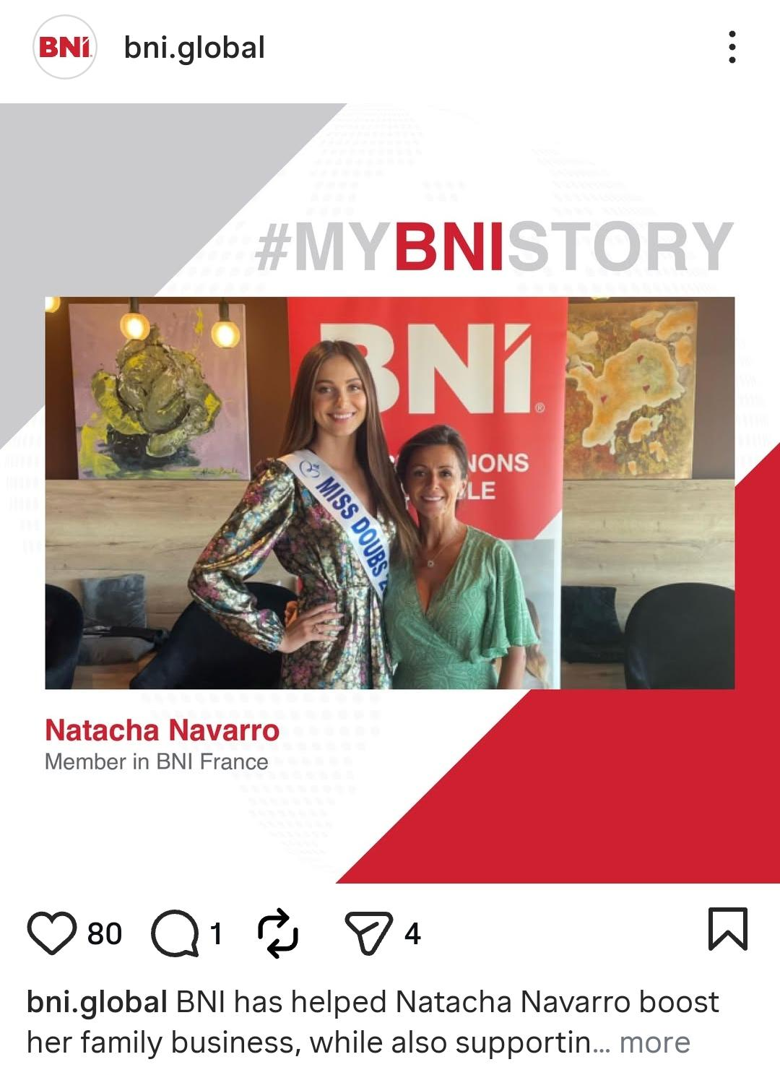
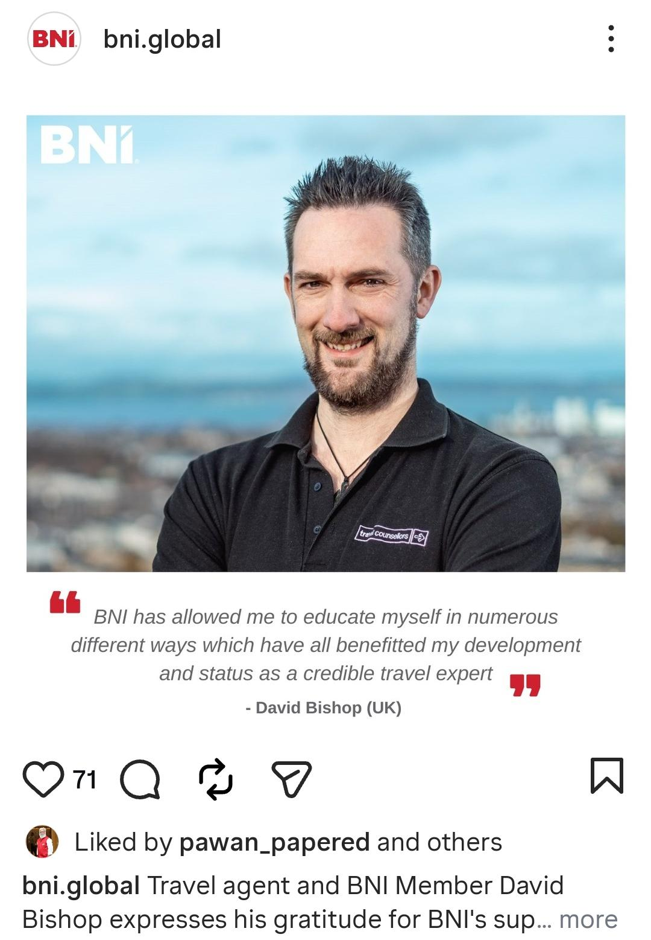
The International Networking Week® Social Media Challenge
Help spark buzz during International Networking Week® and get the chance to be featured. Top posts will appear on BNI Global’s channels, and a few standout stories may even be re-shared by Dr. Ivan Misner.
PART 1
Share Story + Invite Visitor Post
(2 Week Window: January 19 – 30)
Share your favorite networking story and the impact it has made on your life or business.
Add a simple call-to-action to invite a Visitor to your Chapter meeting:
“Want to see the impact for yourself? Join me at my BNI Chapter meeting during International Networking Week, Feb 1 - 7!” (Pro Tip: Don’t forget to add your Chapter’s specific date and time.)
Post on Instagram, Facebook, and/or LinkedIn
Tag BNI Global (How to Tag BNI Global on Social Media)
Use hashtags (#InternationalNetworkingWeek, #BNIaccelerate)
CLICK HERE FOR A FEW CAPTION EXAMPLES

Slide 2
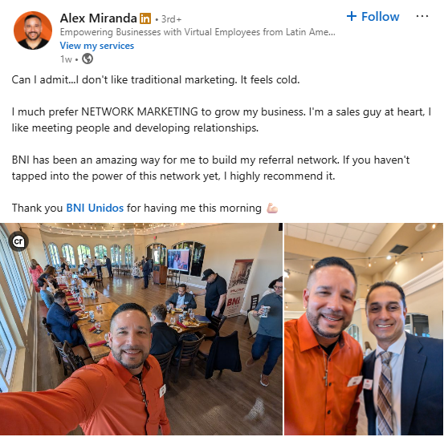
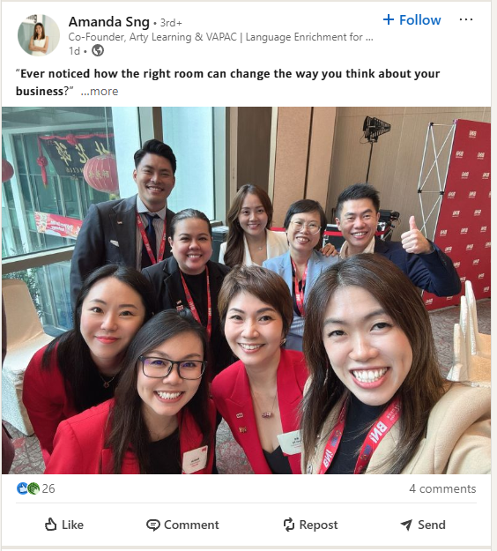
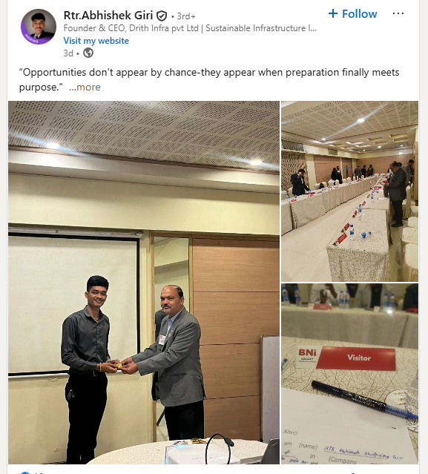
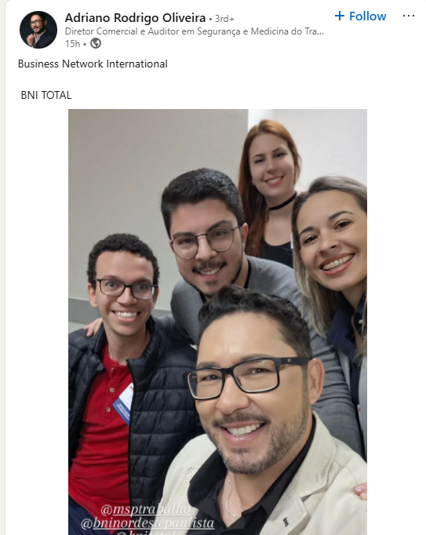
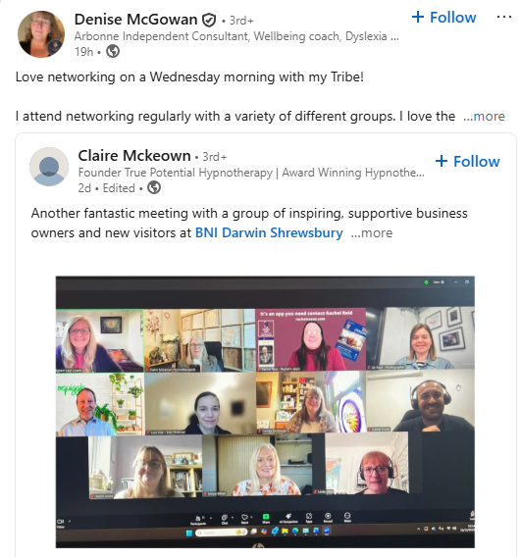
The International Networking Week® Social Media Challenge
PART 2
Bring a Visitor + Share Your Photo (February 1 - 7)
Invite someone to your Chapter meeting during International Networking Week®
Take a photo together at the meeting
Post the photo on Instagram, Facebook, and/or LinkedIn
Tag BNI Global (How to Tag BNI Global on Social Media)
Use hashtags (#InternationalNetworkingWeek, #BNIaccelerate)
Pro Tip: Keep the photo simple and genuine - smiles, name badges visible, and a short caption about why you invited them. It helps others see the real impact of networking.
CLICK HERE FOR A FEW CAPTION EXAMPLES

