Slide 1
WELCOME
Visitor Orientation
Notes:
Thanks for coming today. I hope you met some people and learned some things to help your business going forward. This time on the agenda is dedicated to giving you a bit more information so you can determine whether BNI might be right for your business.
Since most visitors are interested in seeing how referrals could fit into their current marketing strategy, I’d like to show you some information you might find surprising.

Slide 2
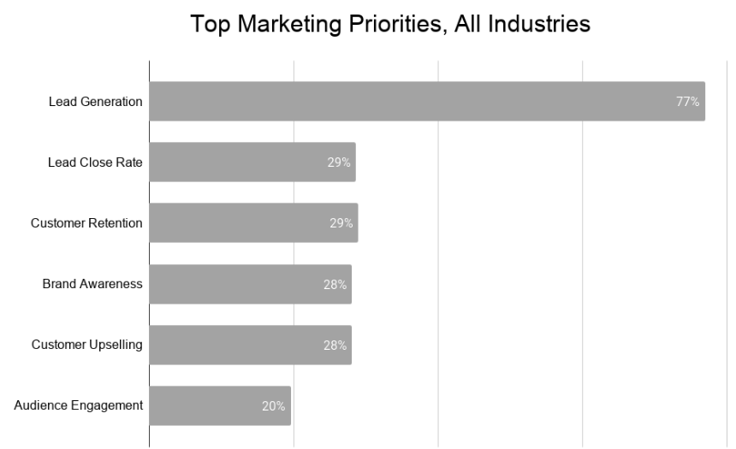
TOP SALES & MARKETING PRIORITIES
IMPROVE
Lead Generation
Close Ratio
Customer Retention
Brand Awareness
Upselling
Audience Engagement
Source: Information Technology Service Marketing Association (ITSMA)
Notes:
If you’re like many business owners, you won’t be surprised to learn that lead generation is the top priority for most businesses.

Slide 3
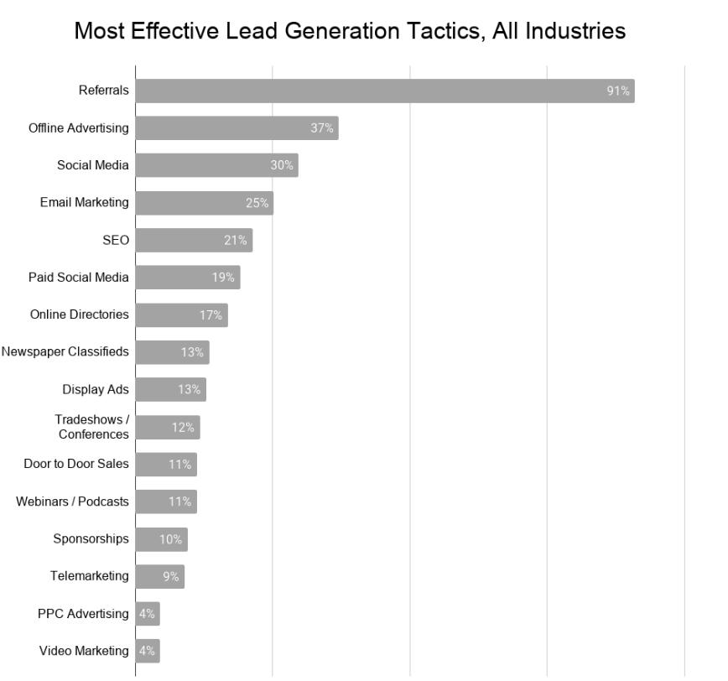
WHAT LEAD GENERATION STRATEGIES ARE MOST EFFECTIVE?
MOST EFFECTIVE LEAD GEN STRATEGIES
(all industries)
Referrals
Digital Advertising
Social Media
Email Marketing
SEO
Paid Social
Online Directories
Classifieds
Display Ads
Tradeshow/Conferences
Door-to-Door
Webinars/Podcast
Sponsorships
Telemarketing
PPC
Video Marketing
Source: Information Technology Service Marketing Association (ITSMA)
Notes:
When we look at which lead generation strategies are most effective, we see that across all industries, referrals are, by far, the most effective strategy.

Slide 4
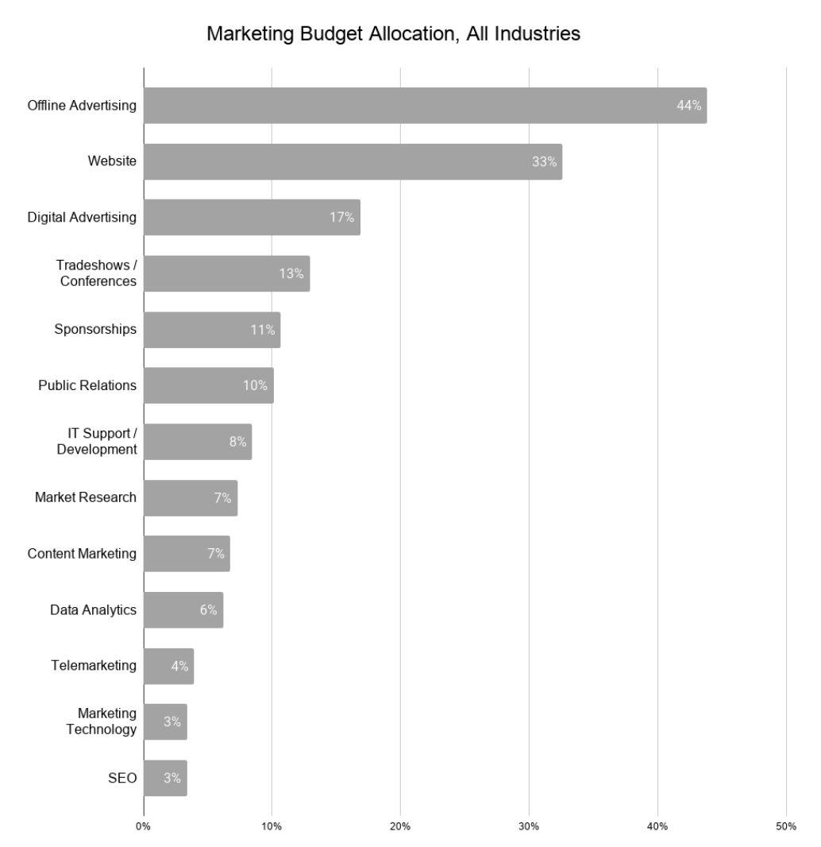
SALES & MARKETING BUDGET ALLOCATION
BUDGET ALLOCATION (all industries)
Online Ads
Website
Digital Ads
Tradeshow/Conferences
Sponsorships
Public Relations (PR)
IT Support / Development
Market Research
Content Marketing
Data Analytics
Telemarketing
Marketing Technology
SEO
Source: Information Technology Service Marketing Association (ITSMA)
Notes:
And yet, here's what’s surprising: Even though generating new leads is the top priority for most businesses, very few companies invest time and money into generating referrals. They're just crossing their fingers and hoping for the best.
The key to meeting your goals in this area is to get intentional about it just like you do your other marketing strategies.

Slide 5
DIFFERENCE BETWEEN REFERRALS & LEADS
REFERRAL
LEAD
Notes:
The beauty of a group like this BNI Chapter is that they’re consistently and intentionally generating referrals. The benefit of these relationships is that the potential client is someone who already knows and trusts the person making the introduction. That’s the power of referral networking. And it’s what you’ve seen work so well during the meeting today.

Slide 6
HOW BNI WORKS
TIME
Weekly Meetings
One-to-Ones
Notes:
First time. Our weekly 90-minute meetings are crucial in building the trust that generates referrals. We want you here. We mark out meeting time on our calendar just like we would a meeting with a client. When you treat BNI like your best client, BNI will become your best client. We all look forward to the opportunity to hang out with like-minded professionals, but we also know that life happens and we can’t always be here, so we allow for 3 absences in a rolling 6-month period and the ability to send a substitute if something comes up.
Outside our weekly meetings, the real magic happens during what we call One-to-Ones. This is when two members meet to share a meal or coffee. In a One-to-Ones, I am going to learn your bragging points... what sets you apart from others in your industry. I want to know what key situations to look for and how to bring you up in conversation. I want to know what I can do to promote you on social media. These become referral strategy sessions when we actively help on another find our ideal clients. Nowhere else will you get this type of commitment that allows you to see an immediate return on your membership investment.

Slide 7
HOW BNI WORKS
MONEY
$699 Membership Fee
$299 Processing Fee
Notes:
Now money. The cost for the year of membership is $XXX, in addition to a one-time $XXX processing fee. It’s not an application fee because it is not paid until you are accepted. There is not a fee to apply. Our Chapter also has a monthly fee of $XX to help pay for coffee and the venue where we meet. For the time commitment and investment of a BNI Membership, nothing compares to the results our Members get from personal referrals.

Slide 8
WHAT’S
NEXT

Slide 9
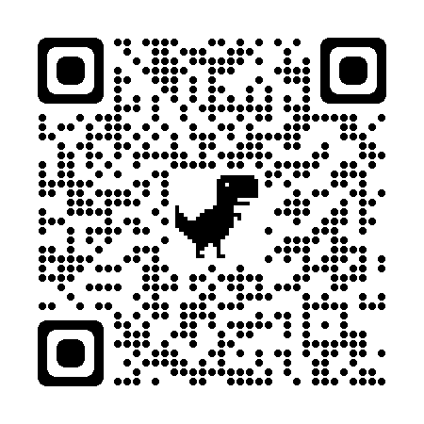
WHAT’S NEXT?
APPLICATION
FOLLOW-UP CALL
https://bit.ly/BNIapplynow
Notes:
Many Visitors at this stage actually want to apply to the Chapter and set up some time to get their questions answered. If that makes sense for you, simply hold your phone’s camera to this QR code for a link to get you started on the process.
If you’re thinking about how this could work for your business, but you need to crunch numbers or talk to someone at home or in your office, that’s ok. Someone from our Chapter will call you in the next 24 hours to see if you have questions.
And if there’s someone you’d like to bring to the meeting next week so they can experience what you’ve experienced today, we’ll help you get registered.

