Slide 1




Global Theme for 2026
Toolkit

Slide 2

Included in the Toolkit
Slides 3 - 13 | Overview & Key Messages | Theme Overview Key Messages (Directors, Members, Public) Talking Points BNI Member Video Testimonials
​Slides ​14 - 18 | Visual Identity & Branding​ | Logo Files​ Brand Guidelines
Slides 19 - 23 | Rollout Materials | Implementation Guide Chapter Presentation Slides Email Templates Frequently Asked Questions
​ Slides 23 - 27 ​ | Digital Tools & Resources | Zoom Virtual Backgrounds​​ PowerPoint Templates Social Media Content Calendar Social Media Graphics

Slide 3

OVERVIEW & KEY MESSAGES

Slide 4
Introducing BNI’s Theme for 2026…

Slide 5

Theme Overview
Theme Definition: ACCELERATE is about propelling our Members, Chapters, and communities forward - faster and stronger than ever. By accelerating together, we drive toward one million Members, deepen trust, and elevate success through powerful collaboration and shared purpose.
Purpose Statement: This year, we aim to ACCELERATE every aspect of BNI - business growth, personal development, passion, mindset, and global impact.

Slide 6
Key Messages (Director-Facing)
BNI is designed to help Members accelerate their business growth.
We Broke through, we went Beyond, and now we are Accelerating towards 1 million Members to amplify the BNI community.
To get to 1 million Members, we need to accelerate our growth strategies and best practices.
The innovation that we have delivered over the last few years enables us to move at a faster pace going forward.
Directors who coach, inspire, and align their teams create the conditions for rapid, sustainable success.
Nail the basics to accelerate growth.
Your leadership is the engine that powers Member growth, Chapter health, and global impact.
We’re not just growing in numbers - we’re driving a movement. As we accelerate, BNI becomes not just known - but recognized - as the global leader in trust-based networking.

Slide 7

Key Messages & Talking Points (Member-Facing)
1. Accelerate Your Business More visibility, more connections, more referrals - faster. BNI gives you the platform to grow your business with momentum.
2. Accelerate Your Network Surround yourself with driven professionals who open doors, expand opportunities, and help you grow - locally and globally.
3. Accelerate Your Confidence Step into leadership, sharpen your pitch, and refine your skills in a supportive, results-driven environment.
4. Accelerate Your Impact The more you give, the more you grow. BNI empowers you to create real value - for your business, your Chapter, and your community.
5. Accelerate with a Global Force Be part of something bigger. Together, we’re transforming how the world does business - one trusted relationship at a time.

Slide 8
5 External Key Messages (Non-Members & Public-Facing)
Accelerate Business Growth
Tap into a global network designed to help professionals grow faster - through real connections, trusted referrals, and powerful collaboration.
Accelerate Opportunity
BNI connects you with motivated business leaders who open doors, expand reach, and fuel success.
Accelerate Momentum
Whether you’re launching or scaling, BNI helps turn business goals into reality - faster than doing it alone.
These five external-facing messages are designed to help you clearly communicate BNI’s value to non-Members, Visitors, and the public.
They’re ideal for use in:
Social media posts and stories
Visitor invites and presentations
Email campaigns or newsletters
Chapter websites or landing pages
Press releases or event collateral
Accelerate Global Impact
With Members in 76 countries, BNI is shaping the future of business through shared values, meaningful relationships, and global connection.
Accelerate Trust
At BNI, relationships come first. And when trust leads, business follows.

Slide 9
What Does It Mean?
ACCELERATE captures the momentum sparked when Members and Directors fully engage with BNI’s values, systems, and relationships - driving results, deepening impact, and elevating success.
BNI ACCELERATES business growth through connection, collaboration, and consistency. Members join to grow - and stay to go further, faster.
The vision for ACCELERATE is to energize Members and Directors to build momentum in mindset, leadership, and results - aligning purpose with performance on the path to one million Members and a thriving global community.
Meaning
Symbolism
Vision
Fun Fact: The needle on the speedometer is angled to match the exact slant of the “I” in the BNI logo.

Slide 10

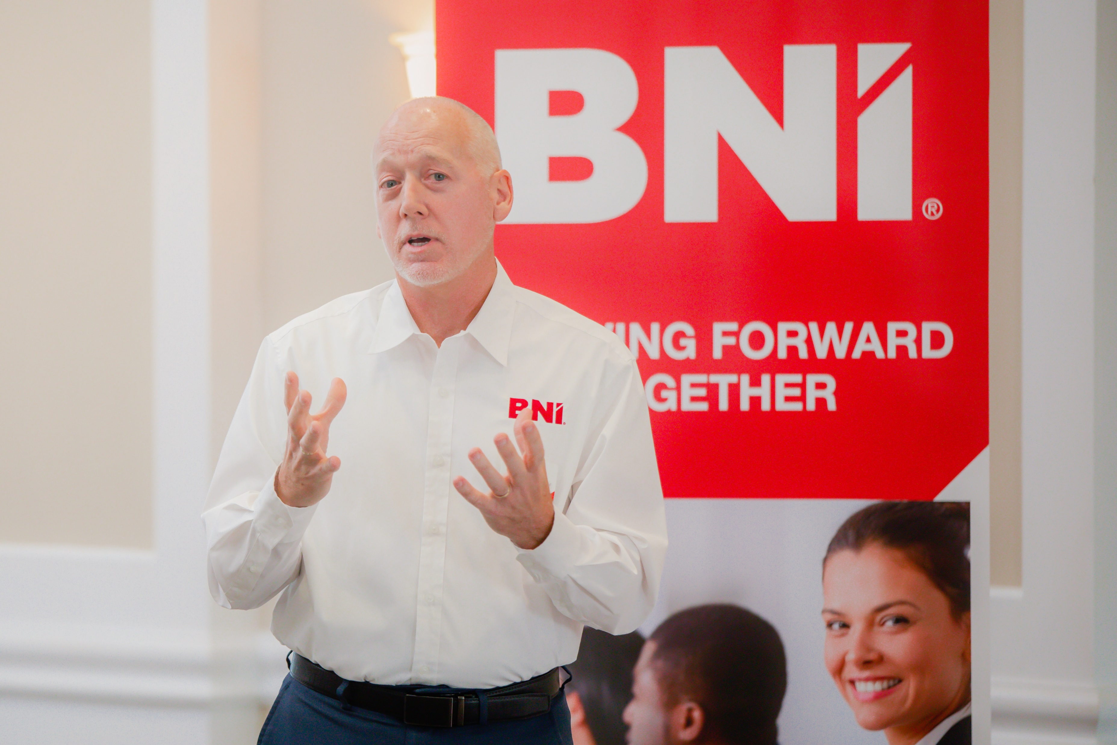
Ideas for integrating the ACCELERATE theme into Communications and Events with these various sub headers:
  Accelerate Growth
  Accelerate Passion
  Accelerate Your Business
  Accelerate Your Mindset
  Accelerate as a Team
  Accelerate Together

Slide 11
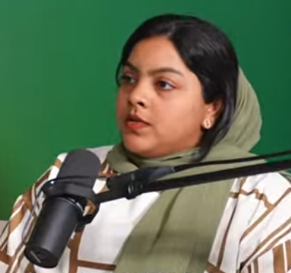

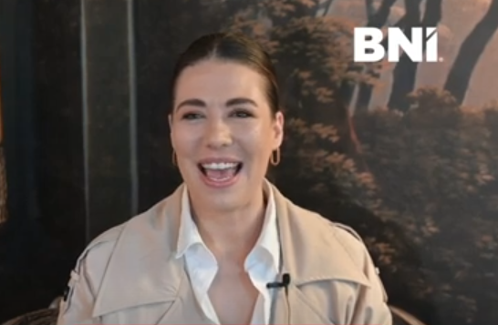
BNI Member Video Testimonials
Shamna Shihabudeen, BNI India
Click here to watch
Kris Wilkins,
BNI United Kingdom
Click here to watch
Danielle Basson,
BNI South Africa
Click here to watch
Here are a few short testimonial videos to get you started! Share these powerful Member stories in your newsletters, emails, and social media to showcase the impact of BNI and inspire Visitors and potential Members to see the value of building strong referral networks to ACCELERATE business growth.

Slide 12
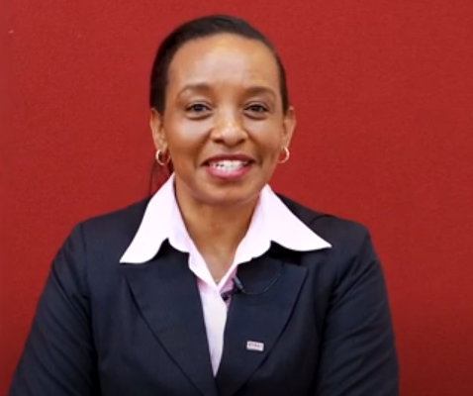
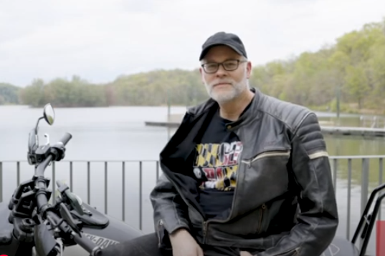

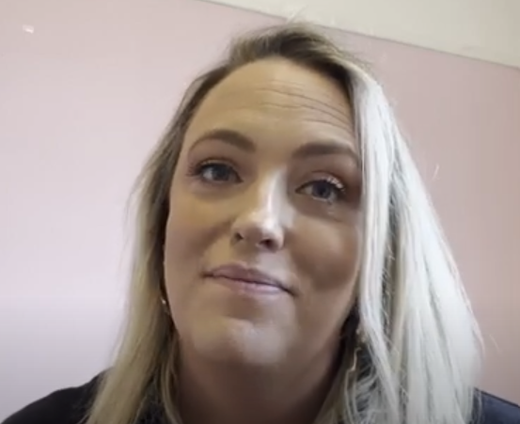
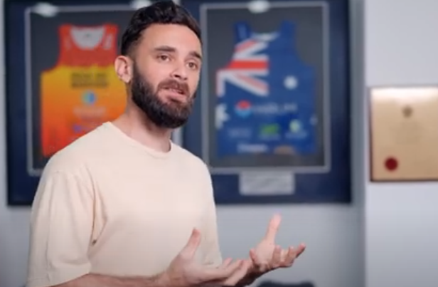
Nancy Kihika,
BNI Kenya
Click here to watch
Brian Loebig,
BNI USA
Click here to watch
Maxi Smith,
BNI USA
Click here to watch
Emily Boardman,
BNI United Kingdom
Click here to watch
David Cejas,
BNI Australia
Click here to watch
#BNIACCELERATE

Slide 13

VISUAL IDENTITY & BRANDING

Slide 14


Logos & Logo Elements (PNG Files)
Click to Download – RED LINES
Click to Download - RED
Click to Download – GREY LINES
Click to Download – GRANITE GREY
Click to Download – WHITE LINES
Click to Download – TRUE WHITE
Click to Download – SPEEDOMETER

Slide 15






Logos – Horizontal & Stacked (PNG Files)
Click to Download – RED HORIZONTAL
Click to Download – RED STACKED
Click to Download – GRANITE GREY HORIZONTAL
Click to Download – GRANITE GREY STACKED
Click to Download – TRUE WHITE HORIZONTAL
Click to Download – TRUE WHITE STACKED

Slide 16
Logos (Adobe Illustrator Files)
Please note that the Adobe Illustrator files are best for high-resolution print or resizing without losing quality.
Click to Download – RED AI File
Branding Reminders:
Always maintain logo proportions - do not stretch or distort.
Leave clear space around the logo to keep it legible and professional.
Use the full-color version when possible; use grey or white versions only when necessary for contrast.
Do not alter the colors, text, or design elements.
Click to Download – GRANITE GREY AI File
Click to Download – TRUE WHITE AI File

Slide 17
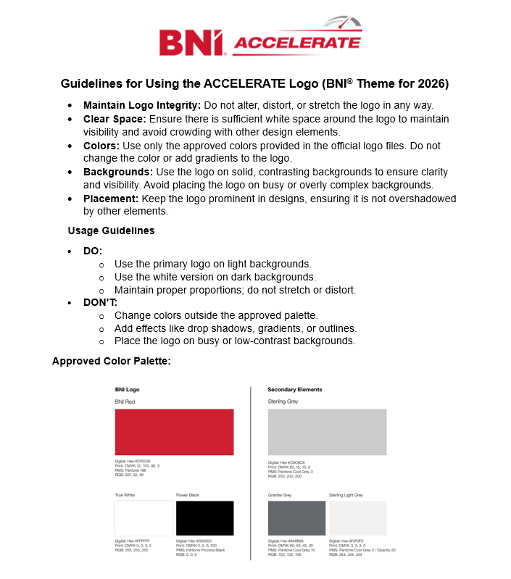
Brand Guidelines
Maintain Logo Integrity: Do not alter, distort, or stretch the logo in any way.
Clear Space: Ensure there is sufficient white space around the logo to maintain visibility and avoid crowding with other design elements.
Colors: Use only the approved colors provided in the official logo files. Do not change the color or add gradients to the logo.
Backgrounds: Use the logo on solid, contrasting backgrounds to ensure clarity and visibility. Avoid placing the logo on busy or overly complex backgrounds.
Placement: Keep the logo prominent in designs, ensuring it is not overshadowed by other elements.
These guidelines help ensure the consistent and professional use of the ACCELERATE logo across all BNI materials.
Download Brand Guidelines One-Pager Here

Slide 18

ROLLOUT
MATERIALS

Slide 19
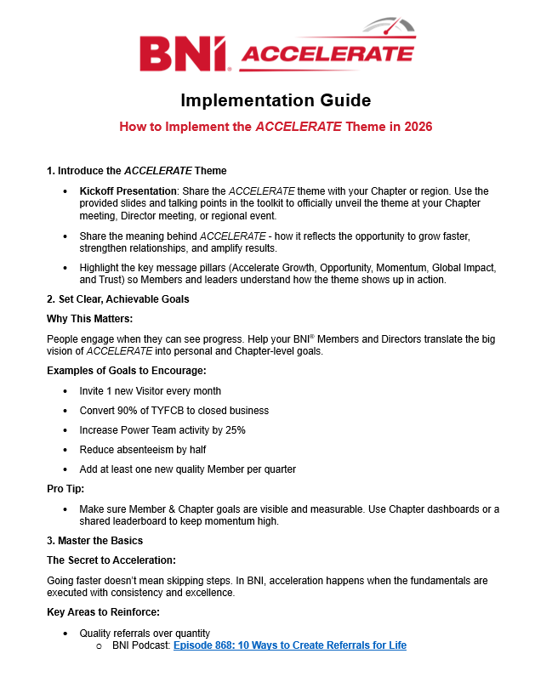
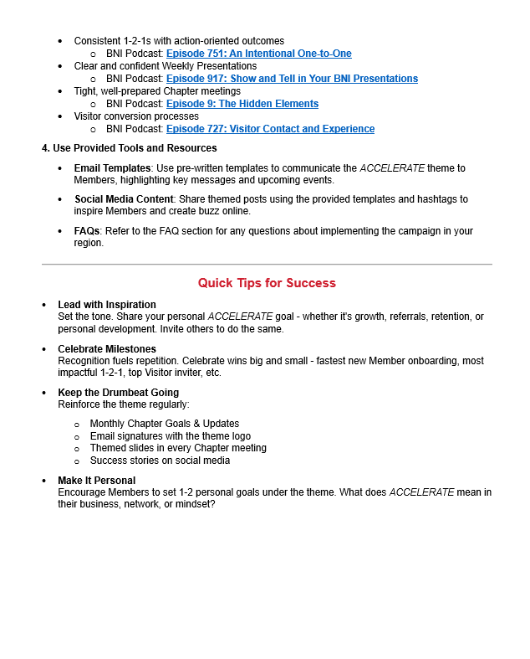
Implementation Guide
How to Implement the ACCELERATE Theme
Introduce the ACCELERATE Theme
Set Clear, Achievable Goals
Focus on Mastering the Basics
Use Provided Tools and Resources
Quick Tips for Success
Lead with Inspiration: Set the tone. Share your personal ACCELERATE goal - whether it's growth, referrals, retention, or personal development. Invite others to do the same.
Celebrate Milestones: Recognition fuels repetition. Celebrate wins big and small - fastest new Member onboarding, most impactful 1-2-1, top Visitor inviter, etc.
Keep the Drumbeat Going: Reinforce the theme regularly.
Make It Personal: Encourage Members to set 1-2 personal goals under the theme. What does ACCELERATE mean in their business, network, or mindset?
Download Guide Here

Slide 20

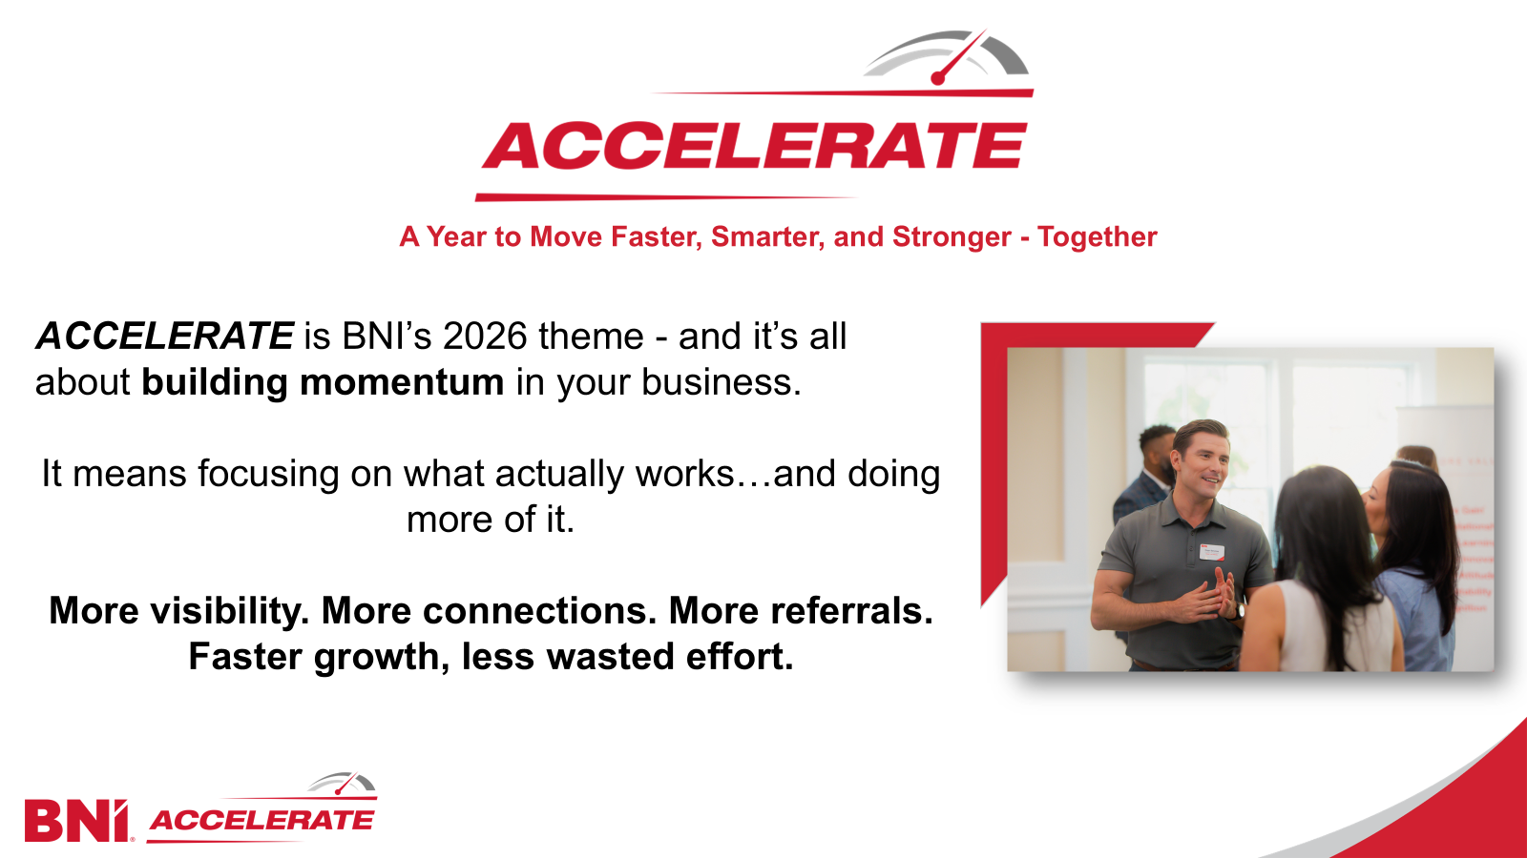
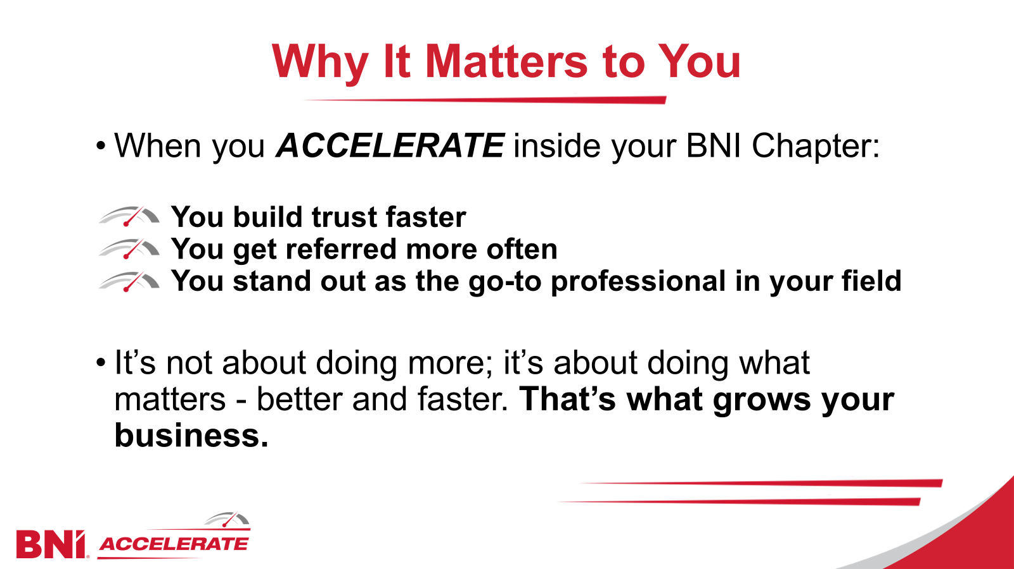
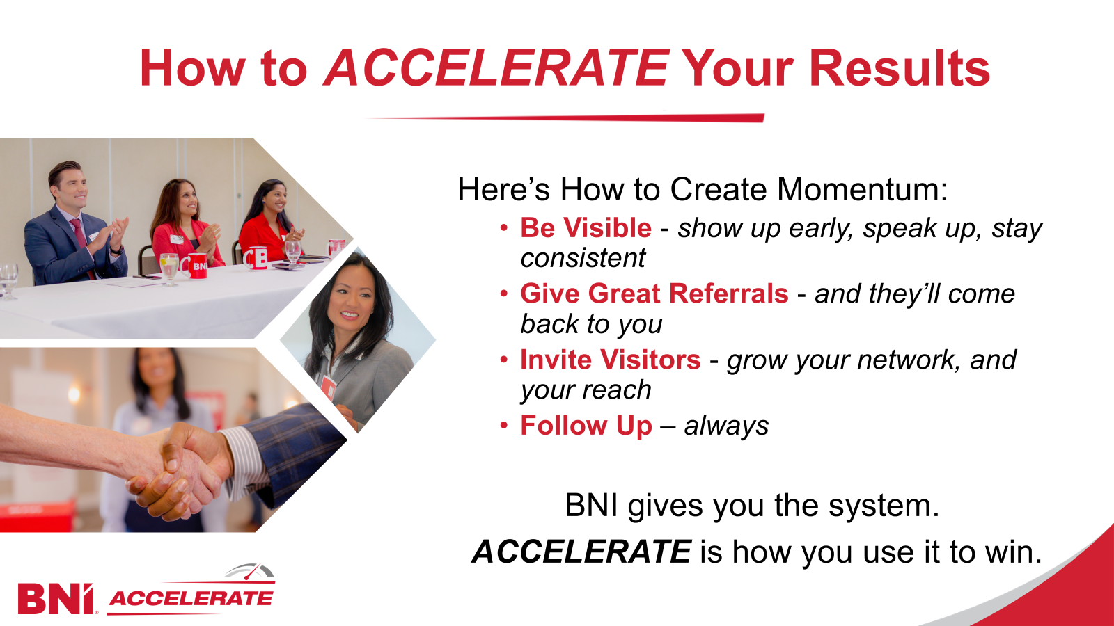
Chapter Presentation Slides
Download these ready-to-use Chapter presentation slides to easily introduce the ACCELERATE theme to your Members, highlighting its purpose, significance, and actionable steps for success.

Slide 21

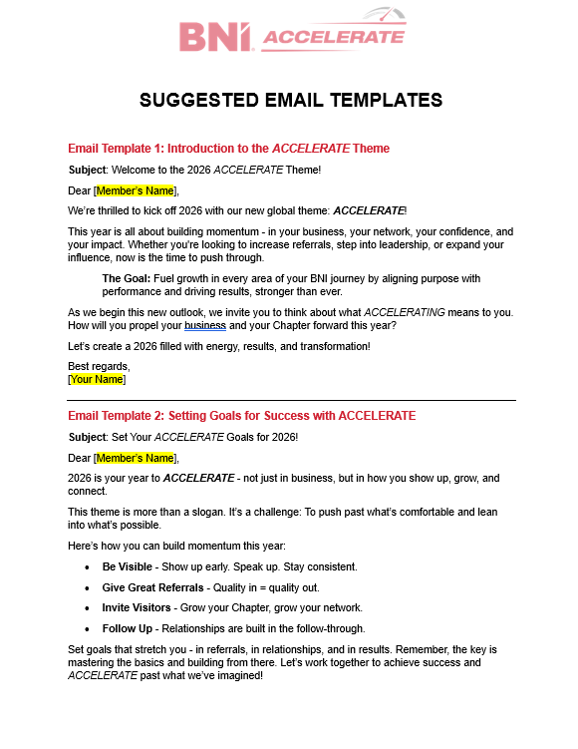
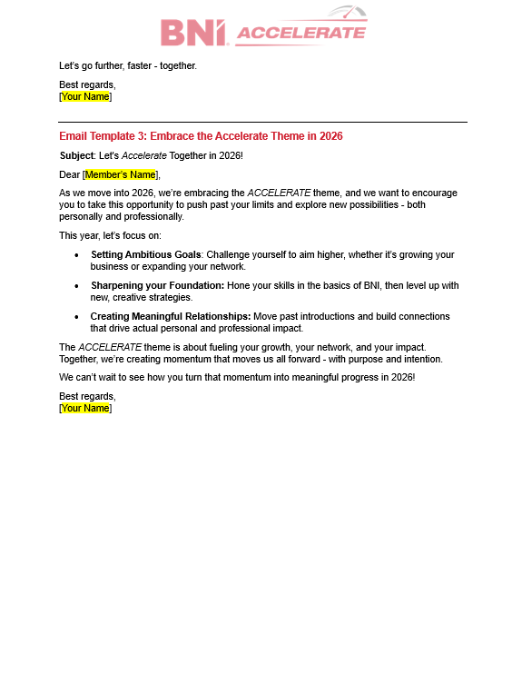
Email Templates
To help you implement the ACCELERATE theme in your Chapters and regions, we’ve provided 3 helpful email templates. These templates are designed to engage your Members and keep them focused on the theme throughout the year.
Download these email templates here and use them to help your Members stay motivated and aligned with the ACCELERATE theme!

Slide 22
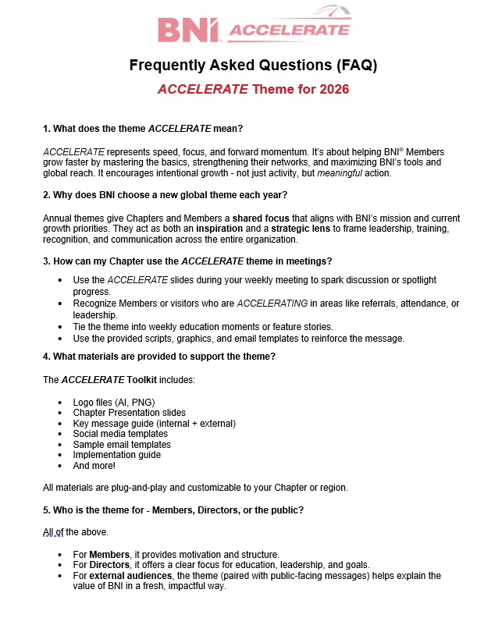
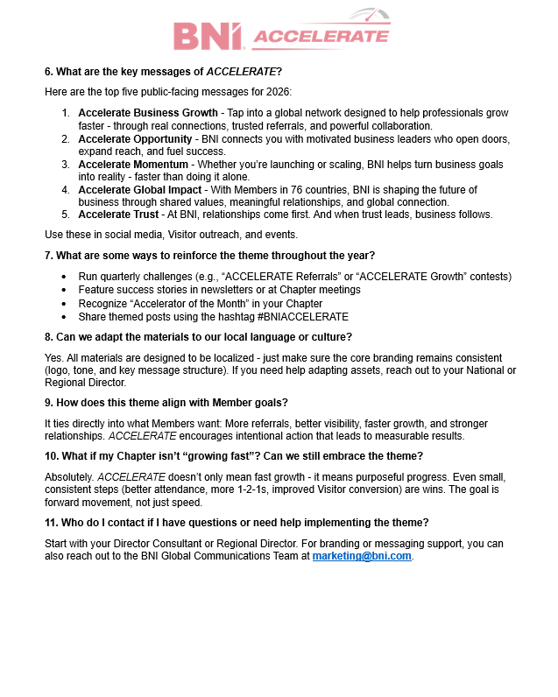
Frequently Asked Questions
Download this comprehensive FAQ to answer common questions and help your Chapters fully embrace the ACCELERATE theme in 2026.

Slide 23

DIGITAL TOOLS
& RESOURCES

Slide 24




Zoom Backgrounds & PowerPoint Templates
Zoom Backgrounds:
Download Here (Basic)
Download Here (Visual)
PowerPoint Templates:
Download Here (Basic)
Download Here (Visual)

Slide 25
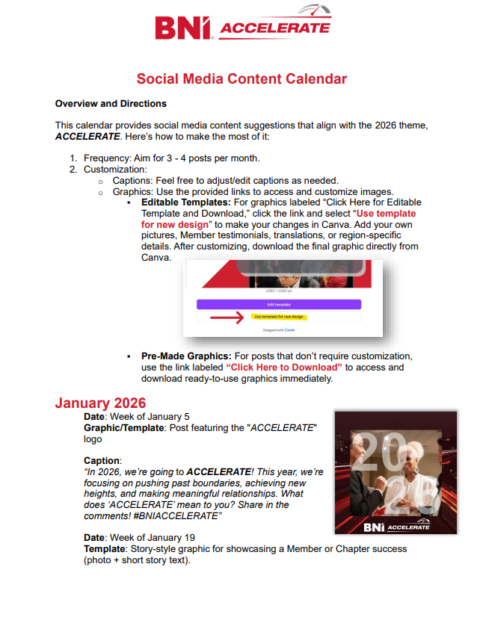
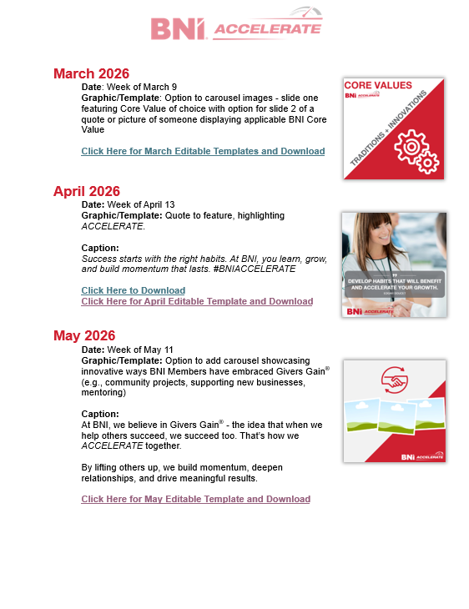

Social Media Content Calendar
Click here to access the 12-month social media content calendar with customizable, editable, and translatable templates, ready to download and share across your social channels.

Slide 26
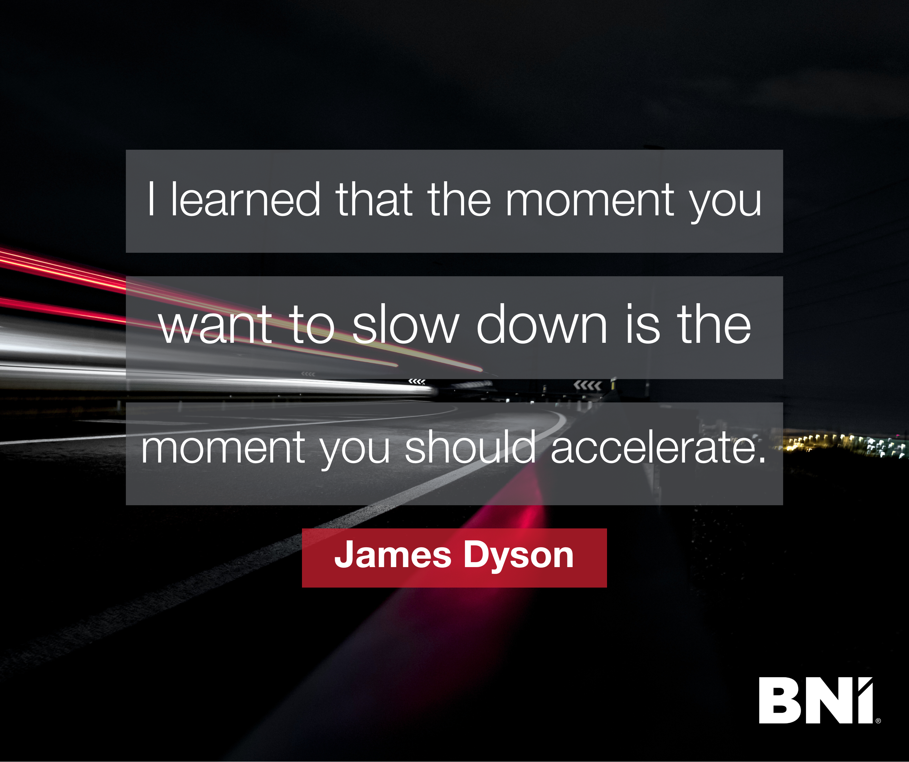
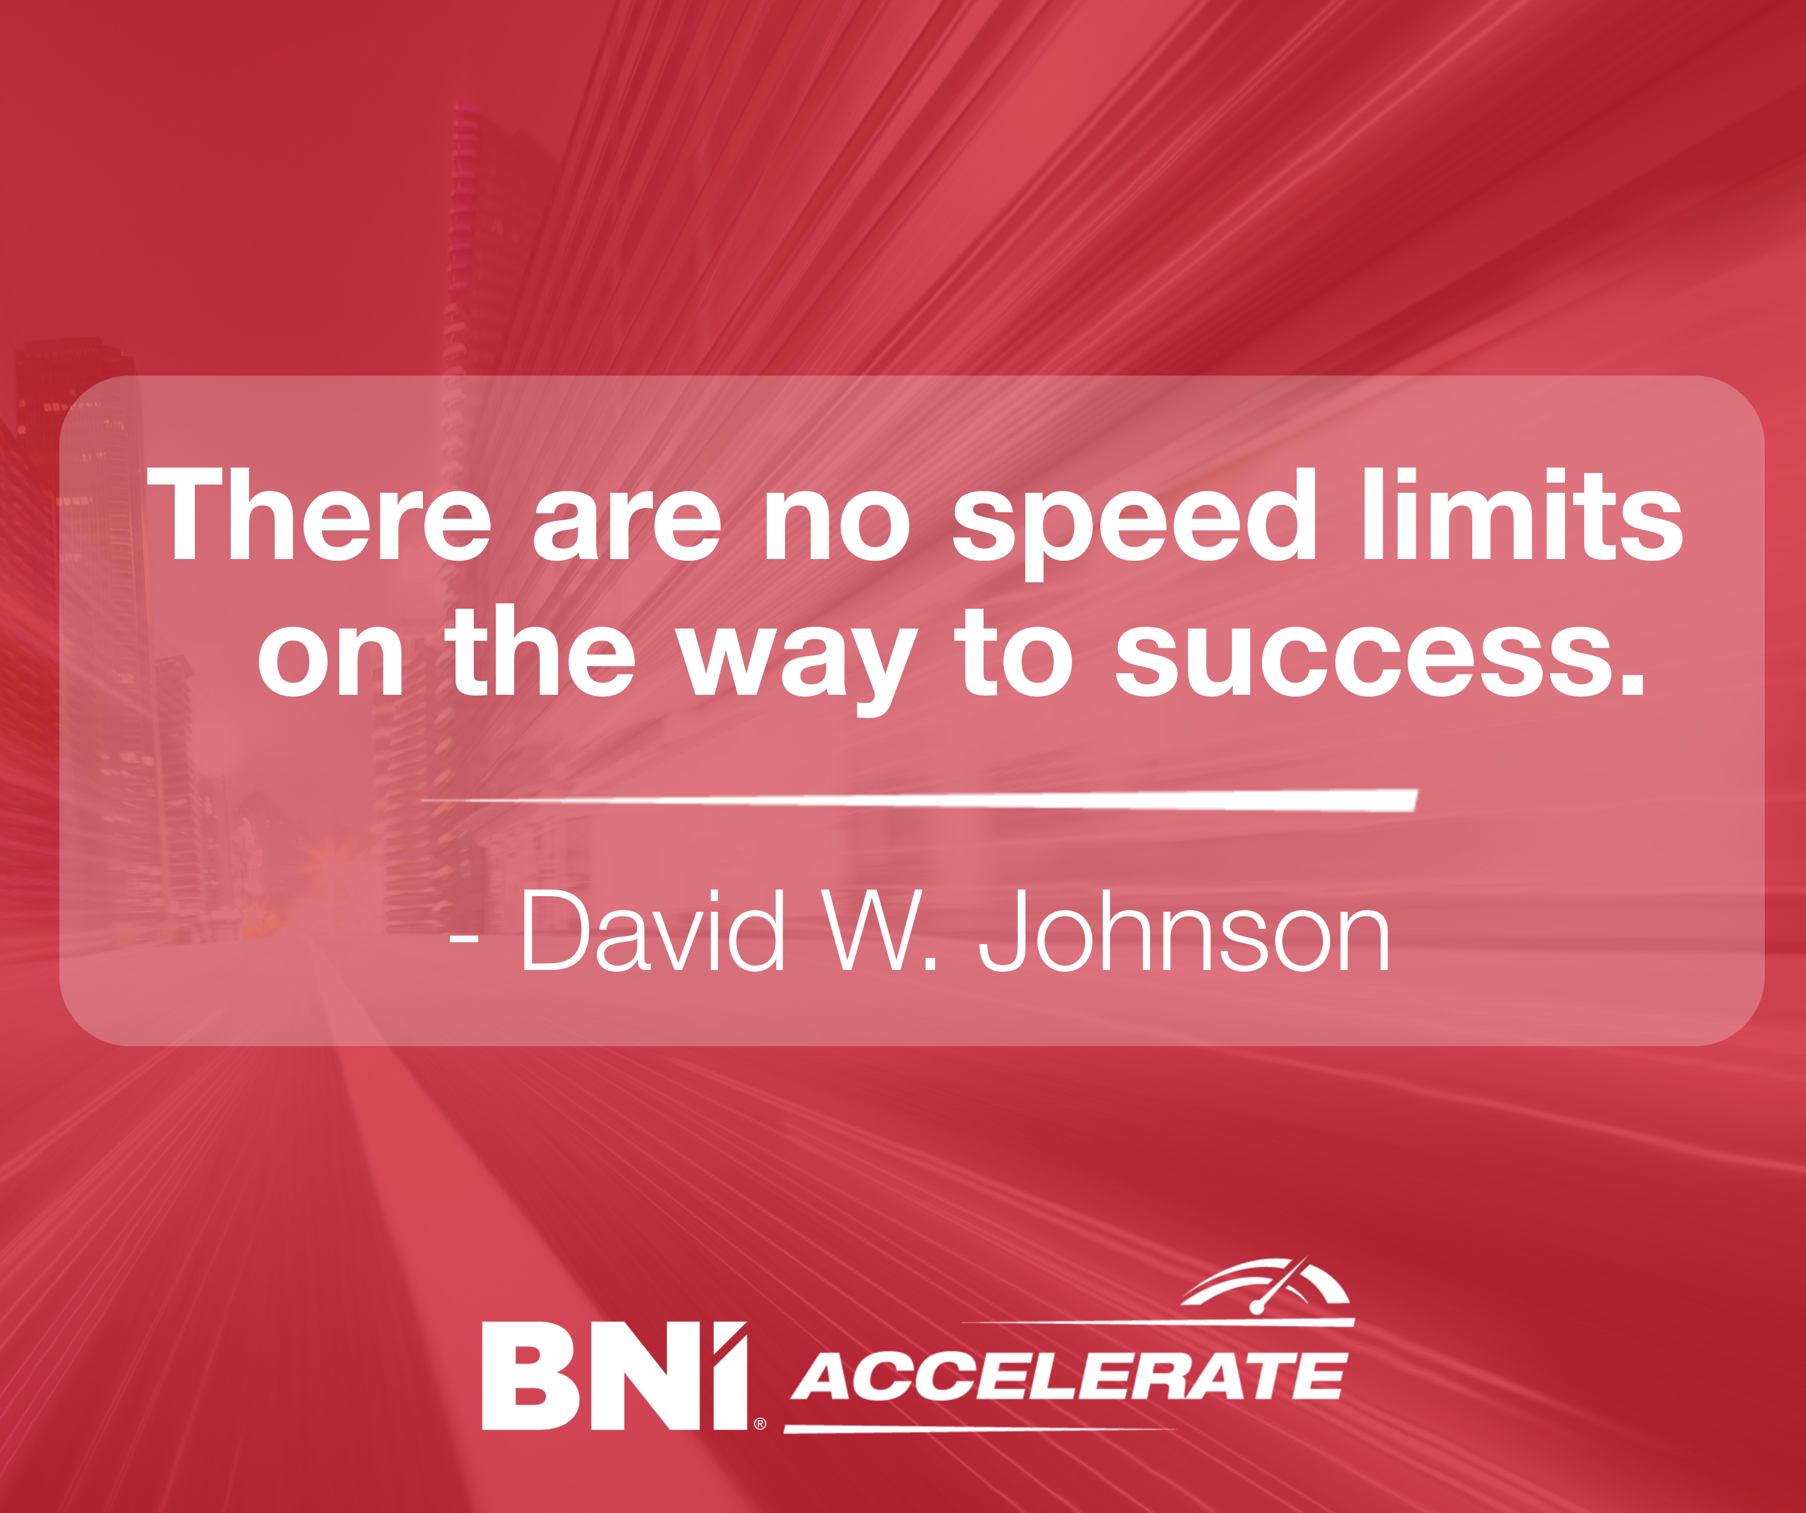
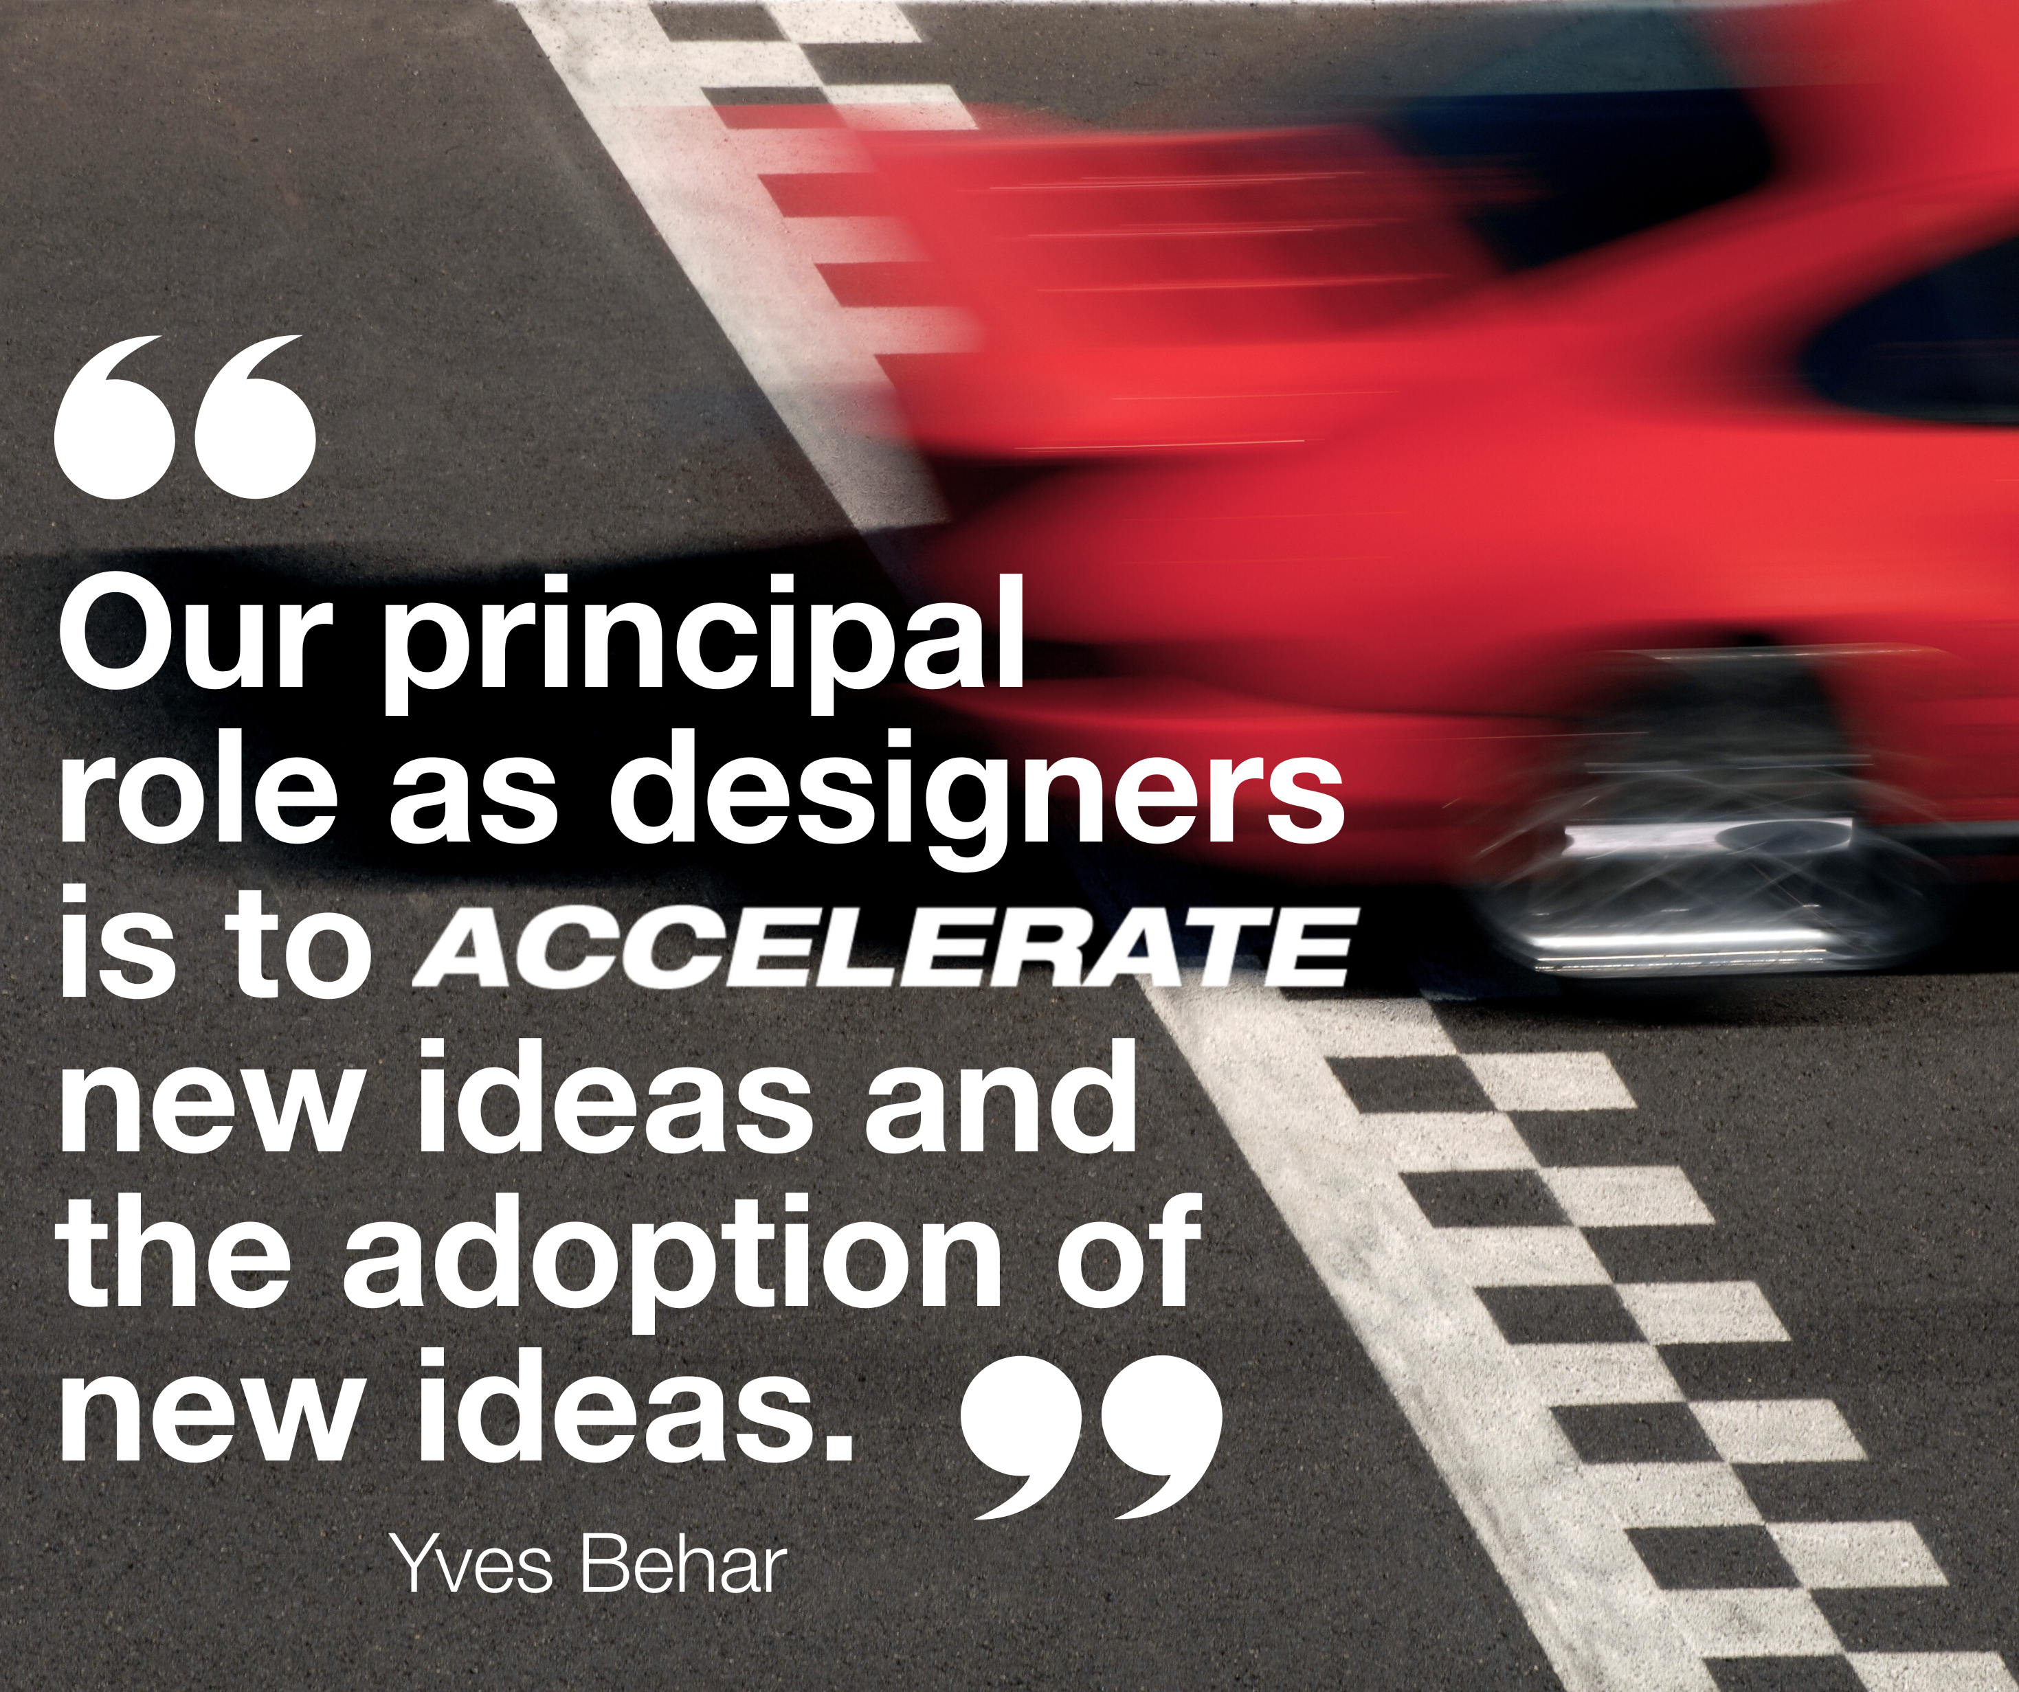


Quote Graphics for Social Media or Presentations
Click here to open the Canva template - you can customize or download the quote graphics for use in social media or BNI Chapter meeting presentations.
Want more inspiration? Click here for extra quotes about ACCELERATE

Slide 27

QUESTIONS?
Contact Us!
Bethany Rippy | bethany@bni.com
Courtney Burke | courtneyburke@bni.com

